Slide 1
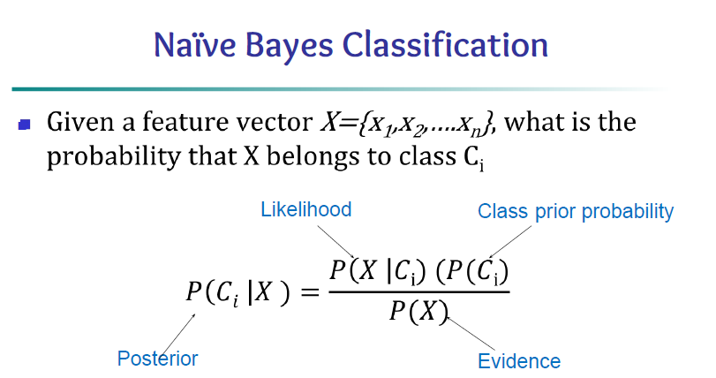

Slide 2
Example-1
Here all features are discrete
Predict whether a person buys computer or not based on attributes such as age, income, student and credit_rating.
Test Data instance
<=30 | medium | yes | fair | ?

Slide 3
Class prior probabilities P(C_{i}):
P(buys_computer = “yes”) = 9/14 = 0.643 P(buys_computer = “no”) = 5/14= 0.357
Test Data instance : X = (age <=30, Income = medium, Student = yes, Credit_rating = fair)
Only calculate P(X|Ci) for above mentioned criteria
Class conditional probabilities P(X|C_{i}):
P(age = “<=30” | buys_computer = “yes”) = 2/9 = 0.222
P(age = “<= 30” | buys_computer = “no”) = 3/5 = 0.6
P(income = “medium” | buys_computer = “yes”) = 4/9 = 0.444
P(income = “medium” | buys_computer = “no”) = 2/5 = 0.4
P(student = “yes” | buys_computer = “yes) = 6/9 = 0.667
P(student = “yes” | buys_computer = “no”) = 1/5 = 0.2
P(credit_rating = “fair” | buys_computer = “yes”) = 6/9 = 0.667
P(credit_rating = “fair” | buys_computer = “no”) = 2/5 = 0.4
Posterior probabilities
P(Ci |X) = P(X|Ci)*P(Ci) :
P(X|buys_computer = “yes”) * P(buys_computer = “yes”)
= 0.222 x 0.444 x 0.667 x 0.667 x 0.643 = 0.028
P(X|buys_computer = “no”) * P(buys_computer = “no”)
= 0.6 x 0.4 x 0.2 x 0.4 x 0.357 = 0.007
Therefore, X belongs to class (“buys_computer = yes”

Slide 4
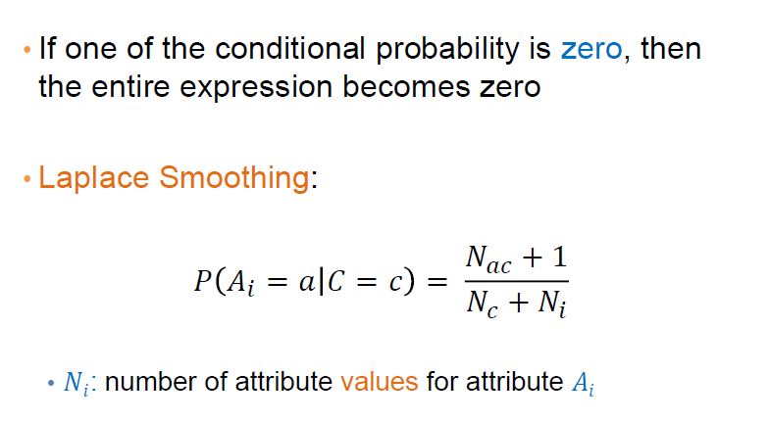
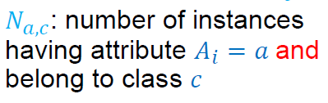
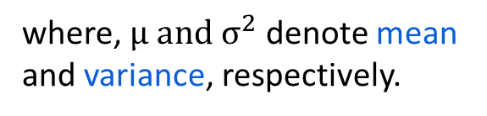
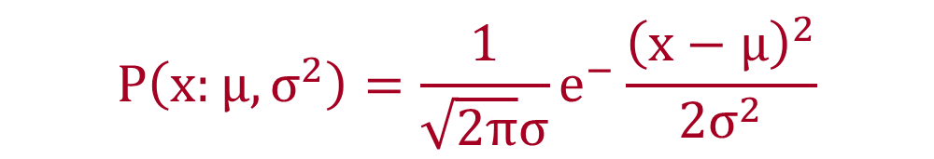
Gaussian Naïve Bayes
This is a variant of the Naïve Bayes classifier, which is used with Gaussian distributions—i.e. normal distributions—and continuous variables. This model is fitted by finding the mean and standard deviation of each class.
$$P\left(x:μ,σ^{2}\right)=\frac{1}{\sqrt{2π}σ}e^{−}\frac{{\left(x−μ\right)}^{2}}{2σ^{2}}$$
where, $μ and σ^{2}$ denote mean and variance, respectively.
Laplace Smoothing
𝑁𝑐: number of instances of
class 𝑐

Slide 5
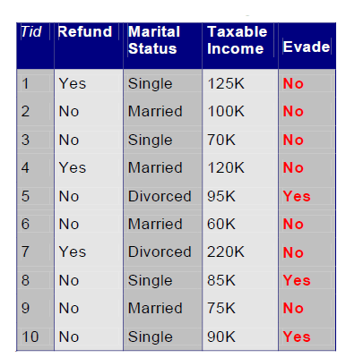
Example

Slide 6
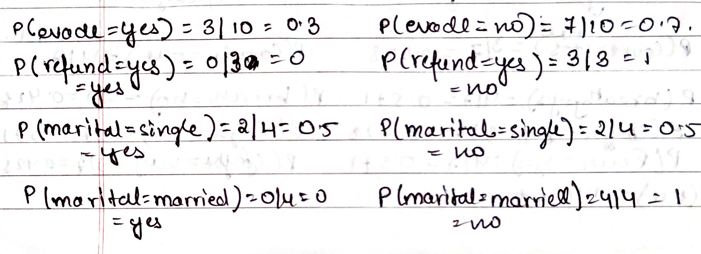

Slide 7
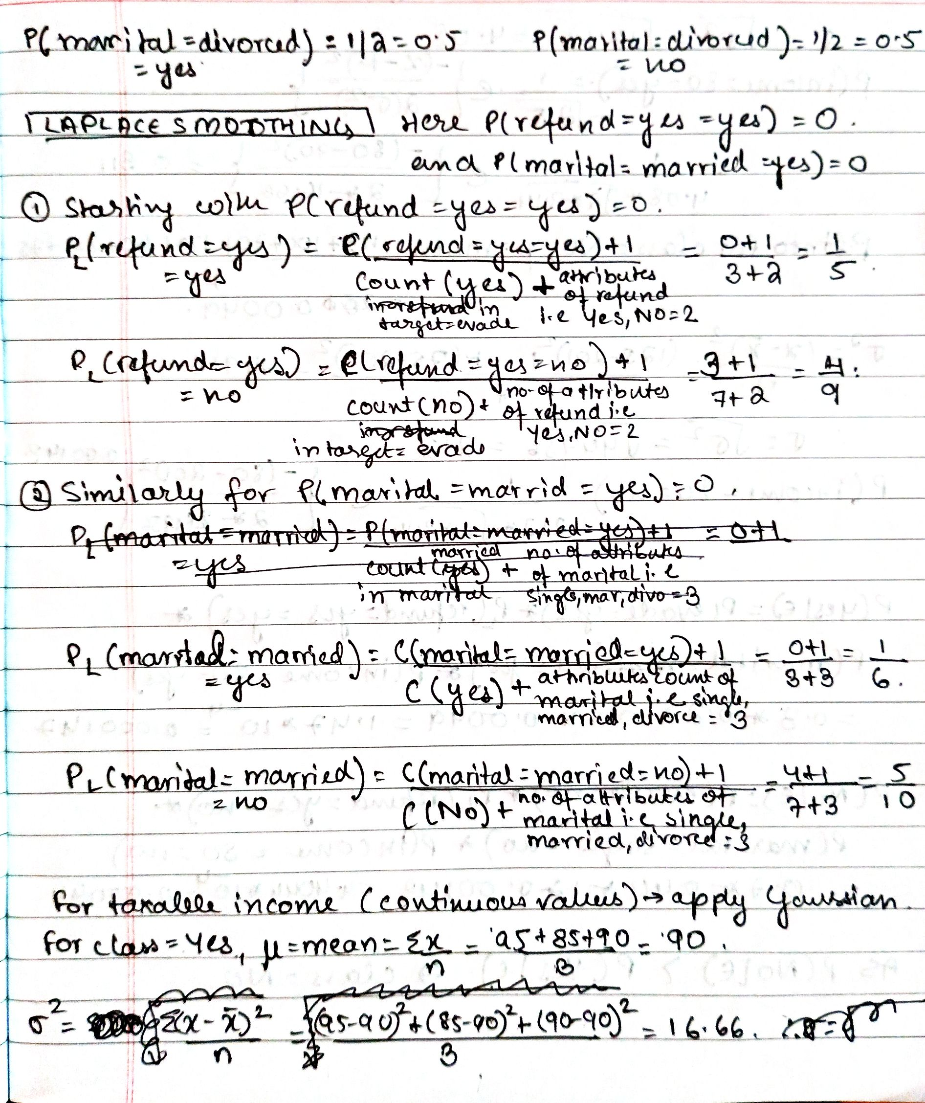
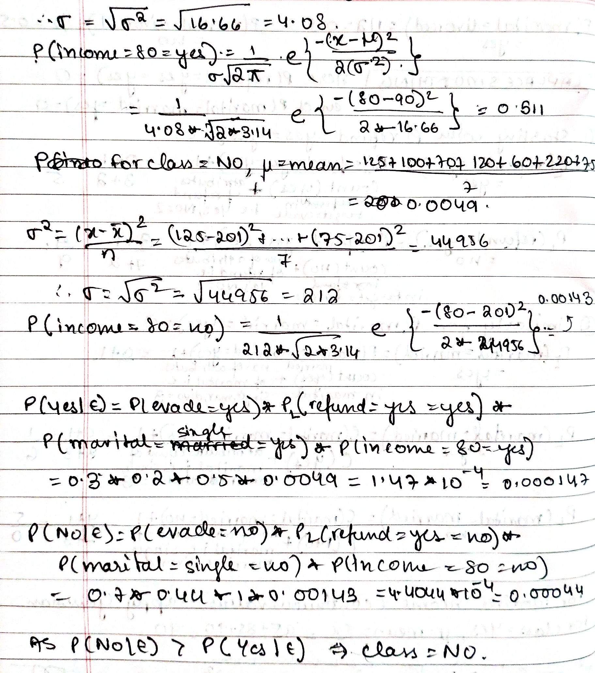

Slide 8
1. Consider the following Employee dataset. In the given dataset Status is the target variable and it indicates whether an Employee is Lazy or Diligent.
Using Naïve Bayes Learning predict the class of an instance with the feature values: < Weight : Normal, Eye Color : Black, IQ level: Excellent>
Weight | Eye Color | IQ level | Status
Normal | Black | Average | Lazy
Normal | Black | Average | Lazy
Normal | Amber | Average | Lazy
Underweight | Black | Good | Lazy
Underweight | Amber | Good | Lazy
Normal | Black | Good | Diligent
Underweight | Black | Excellent | Diligent
Normal | Black | Excellent | Diligent
Normal | Amber | Excellent | Diligent
Underweight | Amber | Good | Diligent
Normal | Amber | Average | Diligent
Underweight | Black | Good | Diligent

Slide 9
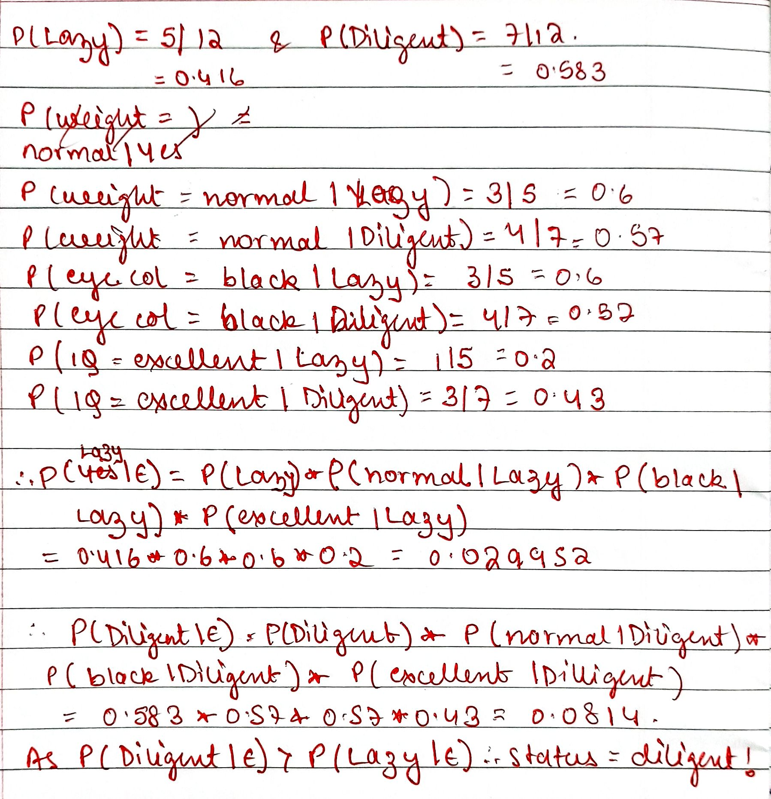

Slide 10
2. Rohan is trying for an data science engineer position in ‘DataMart‘ Company. He has already written a test and attended two rounds of Technical interviews. John’s performance is: <Written Test Score = 66, Technical Round1 = Good, Technical Round2 = Good> .
Use a suitable machine learning algorithm to predict whether he will be selected or not for the Next Round of the Interview using the past data collected from social media for the same position.
Written Test Score | Technical Round 1 | Technical Round 2 | Selection for Next Round
80 | Good | Good | No
70 | Okay | Okay | Yes
65 | Okay | Good | No
68 | Okay | Okay | Yes
72 | Good | Okay | No
69 | Good | Okay | Yes
75 | Okay | Okay | Yes
75 | Good | Good | Yes

Slide 11
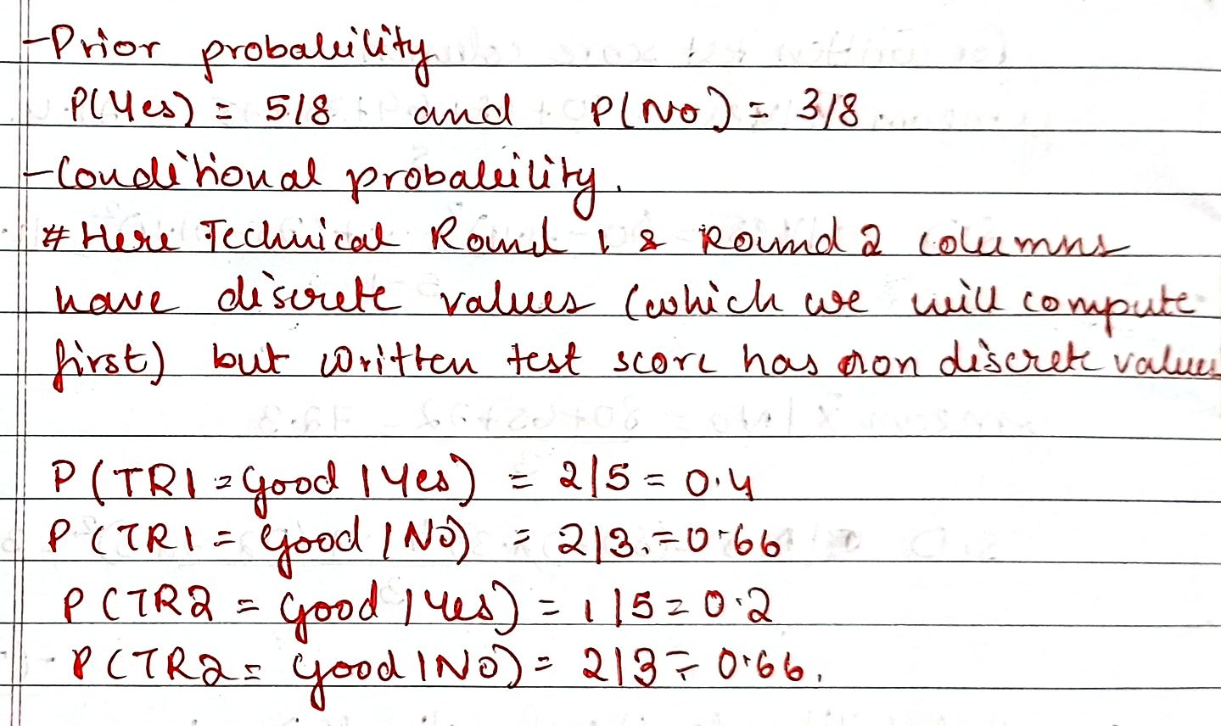

Slide 12
